Slide 1
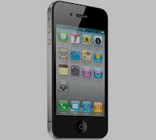
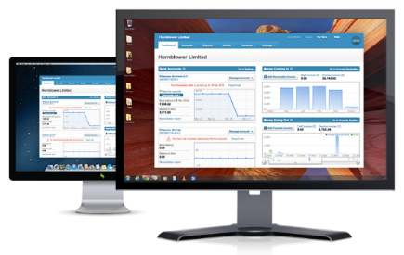



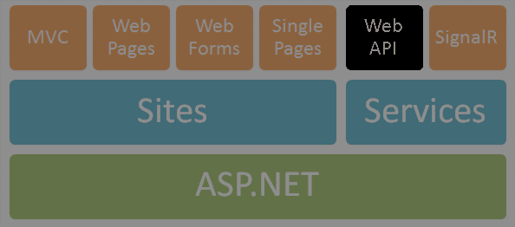
Microsoft Azure
Web Services & Cloud
SoftUni Team
Technical Trainers
Software University
http://softuni.bg

Slide 2

Table of Contents
Introduction to Azure
Web Apps
How to deploy web service application?
Logging
Diagnostics
Configurations
Cloud Services
Virtual Machines
How to deploy on a virtual machine?

Slide 3
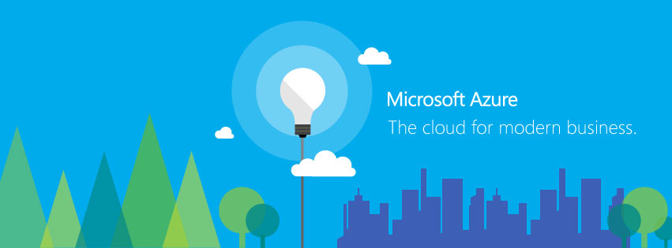
Introduction to Azure
The cloud for modern business

Slide 4



Windows Azure
Your Datacenter
Virtual Machines
Cloud Services
Web Sites
Applications
Applications
Applications
Applications
Data
Data
Data
Data
Firewall
Firewall Rules
Firewall Rules
Network
Virtual Network
Virtual Network
O/S
O/S
Virtualization
Hardware
Focus on the Application
Notes:
Slide Objectives:
Explain the differences between traditional self-hosting and the three options of Windows Azure hosting.
Notes:
In a traditional environment you must manage the full stack. With Windows Azure you can choose a variety of options depending on your needs.

Slide 5
Benefits of the Cloud
Costs Optimization
Quick “Go Live”
Scalability and Global Reach
Security and Maintenance
Microsoft Azure
Notes:
Основни характеристики
Разходи – заемат се и се заплащат само нужните ИТ ресурси
Бърза реализация – няма нужда от изграждане на ИТ инфраструктура
Разширяемост - динамично определяне на капацитета на системата
Сигурност – сертифицирани и строго поддържани „Datacenters“
Минимално (до нулево) засягане на съществуващи системи

Slide 6
Let’s compare with On Premises
Necessity of upfront investments
Maintenance of resources
Potential loss of business focus
Low level of flexibility
Microsoft Azure
Notes:
Ключови аспекти
Първоначална инвестиция
Ресурси за поддръжка на инфраструктурата
Предварителен период на подсигуряване хардуерната обстановка
Проектиране на свързаност с други системи
Отчитане на липсата на гъвкавост в капацитета на системата

Slide 7
Why the Cloud
Rapidly setup environments to drive business priorities
Scale to meet peak demands
Increase daily activities, efficiency and reduced cost.
Speed
Scale
Economics

Slide 8






What is Azure?
Office Add-in
PC
Tablet
Phone
Browser
Games console
On-premises service
On-premises database
Client layer
(on-premises)
Access Control
Layer
AD
Multifactor
Authentication
BizTalk Services
Service Bus
CDN
Traffic Manager
Virtual Networks
Express Route
Integration
layer
API Mgmt
Mobile Services
Websites
Cloud Services
VM
Media Services
Notification Hubs
Scheduler
Automation
Application
layer
Blobs
Tables
Queues
SQL Database
Machine Learning
HD Insight
Caching
Backup and Recovery
StorSimple
Data Layer
Storage
Data

Slide 9






















































Partners

Slide 10









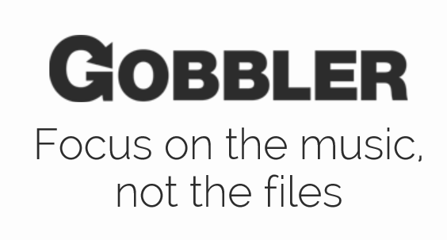















Support for Open Source
Languages
CMS
Devices
Databases / Apps
Operating
systems
Management

Slide 11
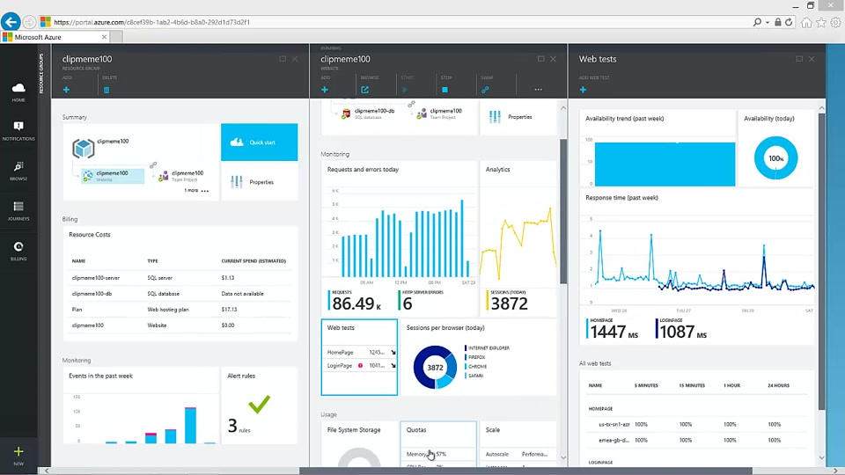
Azure Portal
Live Demo

Slide 12
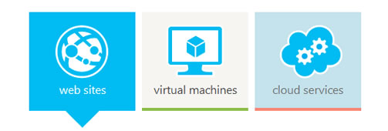
Azure Web Apps

Slide 13
What is Azure Web Apps?
Azure Web Sites is a platform as a service (PaaS)
Cloud computing based platform for hosting websites
Allows publishing web apps written in different platforms
.NET, node.js, Java, PHP, Python

Slide 14
What does Azure Web Apps give us?
Create new sites in seconds
Easily manage and scale your sites
Automatic load balancing and shared storage across instances
Use ASP.NET, ASP, PHP, or Node.js
Supports any Web development tool on any platform
Windows, OSX, Linux
SQL Azure or MySQL databases

Slide 15
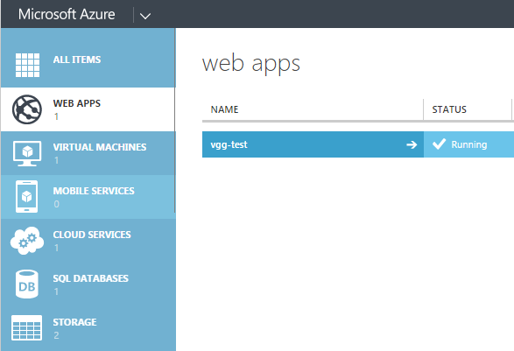
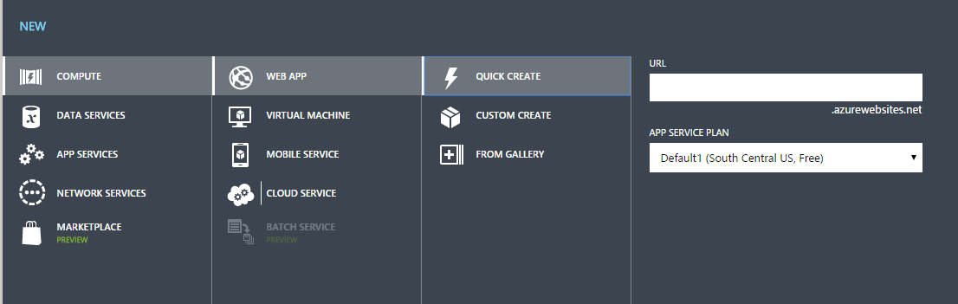
How to deploy application?
Register in Microsoft Azure
Go to Azure Portal
Go to Web Apps
Create new web app
Create new database
Set connection string
Allow Azure IP
Deploy to web app

Slide 16

Azure Web Apps Configuration
You can use .NET, Java, PHP, Python
SSL certificates can be uploaded
SSL bindings to custom domains
Only custom domains can be used
Connection strings can be configured
You can configure Azure Authentication / Authorization
You can scale your web application (cores, memory, instances)
You can add web jobs

Slide 17

Azure Monitoring
You can monitor you application:
CPU Time
Data In
Data Out
HTTP Server Errors
Requests
…

Slide 18
Azure Web Apps
Live Demo

Slide 19
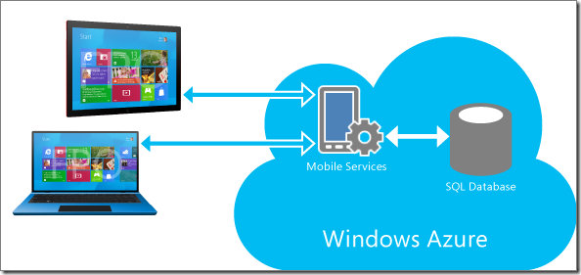
Azure Cloud Services

Slide 20
What is Azure Cloud Service?
Cloud service provides similar functionality as Web Apps
You can deploy IIS-based web app to either of these platforms
Provides a completely provisioned, unique, stateless virtual machine
You have machine level access
Has two different Role Types, a Web Role, and a Worker Role
Gives you much more control over the deployment environment
Provides network isolation

Slide 21
Stages of Service Deployment
Stage 1: Local development and testing
Stage 4: VIP Swap to Production
Stage 3: Test in Staging on Windows Azure
Stage 2: Test in mixed mode with hosted data
Production
Staging
Compute Emulator
Compute Emulator
Role
Role
Cloud Service
Role
Role
Role
Role
Storage Emulator
Windows Azure Storage Service
Windows Azure Storage Service
Notes:
Slide Objective
Highlight the stages of a typical deployment
Local development
Hybrid of local and Windows Azure
Everything in Windows Azure in staging
Swap from Staging to Production
Speaking Points
Debugging is not currently supported in Windows Azure
Set breakpoints & debug in Local Development Fabric.
Test initially with development storage, but test with Windows Azure storage to test with large volumes of data whilst still keeping your roles local for debugging
Once you are happy with the Worker/Web Roles running locally deploy everything to Staging and run tests in this environment
Once all tests in staging pass, promote everything to production
Worker roles in the “Staging” project are operational – and as such will process messages from queues etc. You should design for this.

Slide 22
Azure Cloud Services
Live Demo

Slide 23


Azure Virtual Machines

Slide 24
What is Azure Virtual Machine?
Launch virtual machine in minutes
Supports Windows Server, Ubuntu Server, Suse Linux, CoreOS, Oracle Linux, Open Logic
You have remote desktop access to the virtual machine
You have full control over the virtual machine
You should maintain, update and secure the virtual machine
You should install all software

Slide 25
Azure Virtual Machines
Live Demo

Slide 26
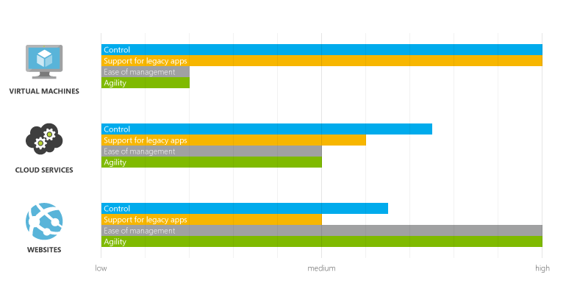
Web Apps vs Cloud Services vs Virtual Machines

Slide 27









Azure
https://softuni.bg/courses/web-services-and-cloud/

Slide 28
License
This course (slides, examples, demos, videos, homework, etc.) is licensed under the "Creative Commons Attribution-NonCommercial-ShareAlike 4.0 International" license
Attribution: this work may contain portions from
"Web Services and Cloud" course by Telerik Academy under CC-BY-NC-SA license

Slide 29






Free Trainings @ Software University
Software University Foundation – softuni.org
Software University – High-Quality Education, Profession and Job for Software Developers
softuni.bg
Software University @ Facebook
facebook.com/SoftwareUniversity
Software University @ YouTube
youtube.com/SoftwareUniversity
Software University Forums – forum.softuni.bg

